Slide 1
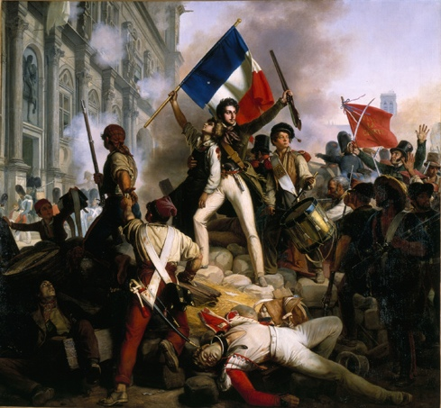
French Revolution
To Napoleon
Notes:
1

Slide 2
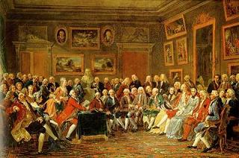
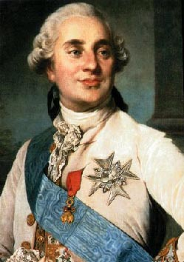
Causes of the Revolution
1. The Enlightenment - enlightenment thinkers spread the ideas of limited monarchy and freedom for all
2. Weak leadership of Louis XVI – Louis was more concerned with hunting than ruling
3. Crop failure and war debts lead to economic crisis – France was in debt after helping the U.S.A. get their independence from England.
Notes:
2

Slide 3
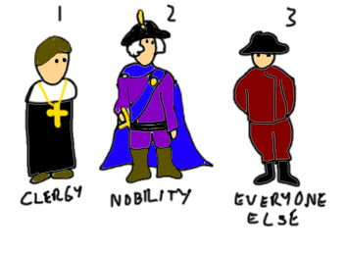
French Estates
The 3rd Estate was forced to pay 50% in taxes and were growing increasingly frustrated.
Notes:
3

Slide 4
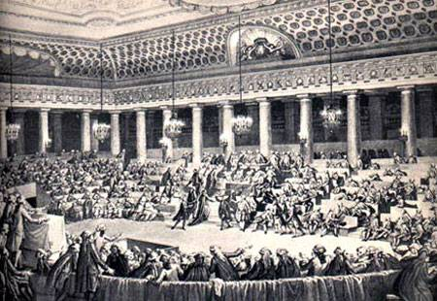
Estates-General Meeting
The 3rd Estate refused to vote by the old rule. The 3rd Estates took control and declared themselves the National Assembly
The National Assembly had the power to make laws
Notes:
4

Slide 5
Tennis Court Oath
Louis XVI locked the 3rd Estate out of the meeting hall
The 3rd Estate met on an indoor tennis court and vowed they would not leave until a new constitution was written
Notes:
5

Slide 6
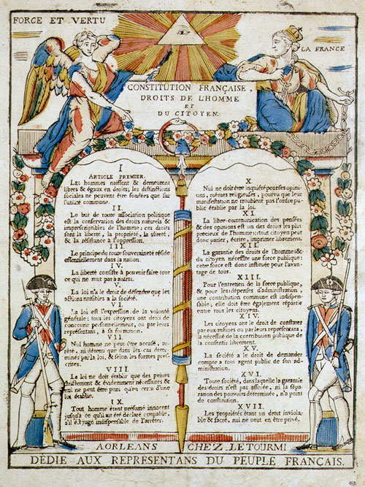
Declaration of the Rights of Man
– declared that all citizens had the rights of freedom and equality
Notes:
6

Slide 7
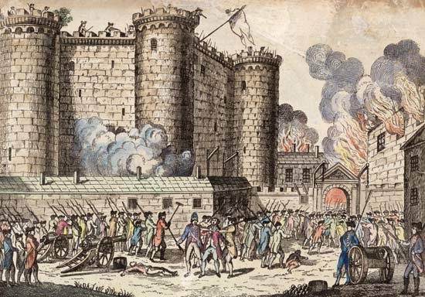
Storming of the Bastille
The Paris Commune stormed the Bastille (armory and prison) in search of gun powder.
July 14th is considered Independence day in France
Notes:
7

Slide 8
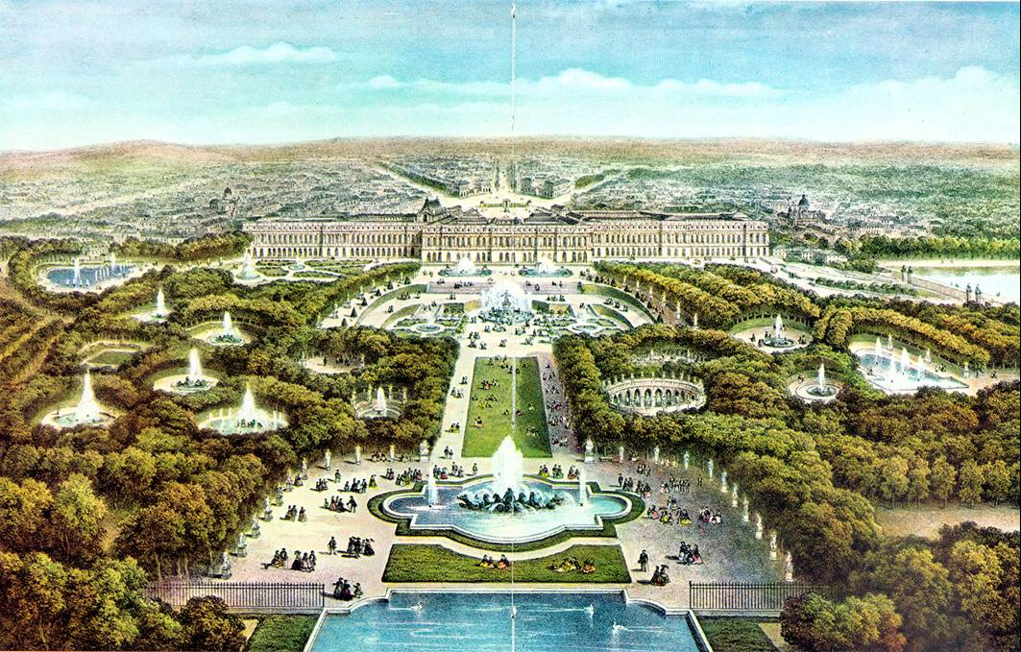
Woman’s Bread March
A mob marches to the palace of Versailles to protest the high cost of bread.
The women stormed the palace and Louis XVI was forced to move to Paris
Notes:
8

Slide 9
What should we do with the king?
The Plain –
swing vote
The Giordins
– want the king to keep his power
The Mountains
– want to kill Louis
Notes:
9

Slide 10
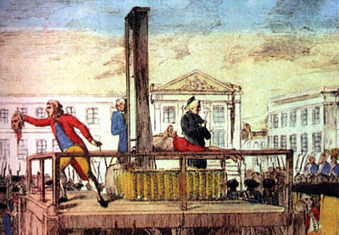
Louis XVI is beheaded for treason and a republic is established
A Foreign Coalition (England, Prussia, Austria, etc.) was formed to stop the revolution.
Notes:
10

Slide 11
The Reign of Terror
The Committee of Public safety was formed to find enemy’s to the revolution
Maximillien Robespierre led the committee
40,000 people were killed at the guillotine
Notes:
11

Slide 12
Coup d'état
The reign of terror ended when Robespierre was beheaded
A New government was created called ‘The Directory’ and was very corrupt
Napoleon staged a coup d'état (overthrow of the government)
Notes:
12

Slide 13
Napoleon Bonaparte
Born on the island of Corsica
Moved to Paris at age 15
Defended France during from foreign invasion during the Reign of Terror
Goal was to conquer the world
Notes:
13

Slide 14
Napoleon’s Reforms
1. Set up tax collection system – all estates had equal taxation
2. Created lycess – school system to guarantee that government officials were educated
Made peace with the Catholic Church – gave back church land taken during the revolution.
4. Created the Napoleonic code – legal code
Notes:
14

Slide 15
Napoleon and the World
Napoleon crowned himself Emperor with dictatorial powers
Napoleon began taking control of surrounding European countries
A foreign coalition (England, Prussia, Austria, etc.) formed to overthrow Napoleon.
The French colony of Haiti had a slave revolt.
Napoleon could not focus on the French colonies so he sold the United States the Louisiana Purchase
Notes:
15

Slide 16
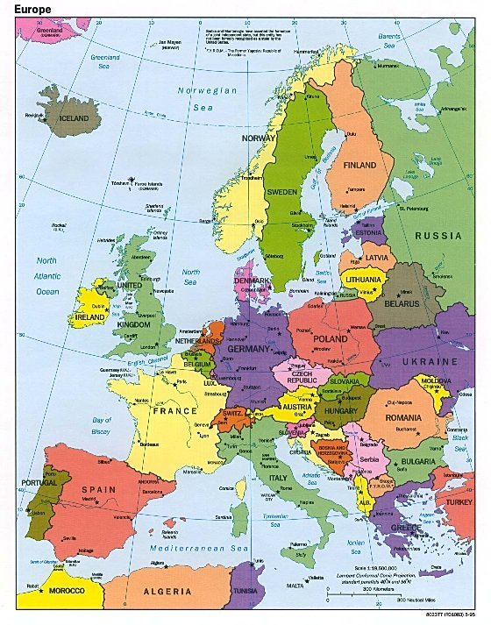
Napoleon’s 3 Mistakes
1. Continental System - Napoleon blockaded Europe from trading with Britain.
2. Peninsular War – French troops are defeated in a war with Spain and Portugal.
Invasion of Russia – Russians used slash and burn technique.
Cold Russian winter forced Napoleon to turn back.
Napoleon lost - 500,000 troops
Notes:
16

Slide 17
Napoleon’s 1st Defeat
Napoleon was defeated at the Battle of Leipzig while returning from Russia
Napoleon was exiled to the island of Elba
Napoleon escaped from Elba and returned to France to rule for 100 Days
Notes:
17

Slide 18
Napoleon’s Final Defeat
Napoleon was defeated by the Duke of Wellington at the Battle of Waterloo
Napoleon was exiled to St. Helena
Napoleon died 6 years later. (poison????)
Notes:
18

Slide 19
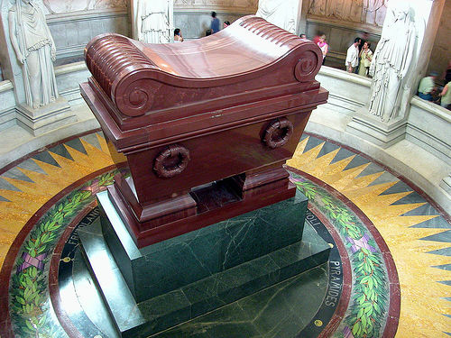
Napoleon ‘s body is buried in Paris France
Notes:
19

